Slide 1
Annual Interagency Accessibility Forum
Accessibility: A Foundation for Inclusion, Diversity, and Equity
October 12-14, 2021
Creating a Machine-Readable ACR

Slide 2
What we are going to cover
Why the world need a machine-readable VPAT
The GSA's work on OPAT
Next steps

Slide 3
Why the world need a machine-readable VPAT
Most Accessibility Conformance Reports (ACRs) are not updated on pace with continuous digital product releases
A static format (example: MS Word) makes it difficult to perform automated comparisons between versions or similar products
ACRs are usually private documents, difficult to find, and not visible to the public
There is no opportunity for public input or bug reporting to an ACR
ACRs are not built to align with existing W3C Initiatives

Slide 4
What the is Open Product Accessibility Template (OPAT)?
A standardized, machine-readable ACR that is built with a common technical format known as YAML.
A project which will include a collection of tools to support writing/editing, validating, comparing, and analyzing ACRs.
An extension of existing VPAT documentation to align more closely with existing software best practices, such as version control.
An open source project designed as a foundational piece of a comprehensive accessibility strategy.

Slide 5
Goals
TRANSPARENCY
Easily comparable compliance reports.
VALIDATION
Confidence that reports meet minimum standards.
Goals
VERSIONING
ACRs should follow digital best practices.
AGGREGATION
Enterprise-wide accessibility confidence.

Slide 6
GSA's work on OPAT thus far
A machine-readable semantic version aligned with Section 508
A built-in validation layer to ensure data quality and integrity
Markdown output from semantic layer (HTML will be available soon)
Notes:
https://github.com/GSA/open-product-accessibility-template https://github.com/GSA/open-product-accessibility-template/blob/main/opat/drupal-9.yaml

Slide 7
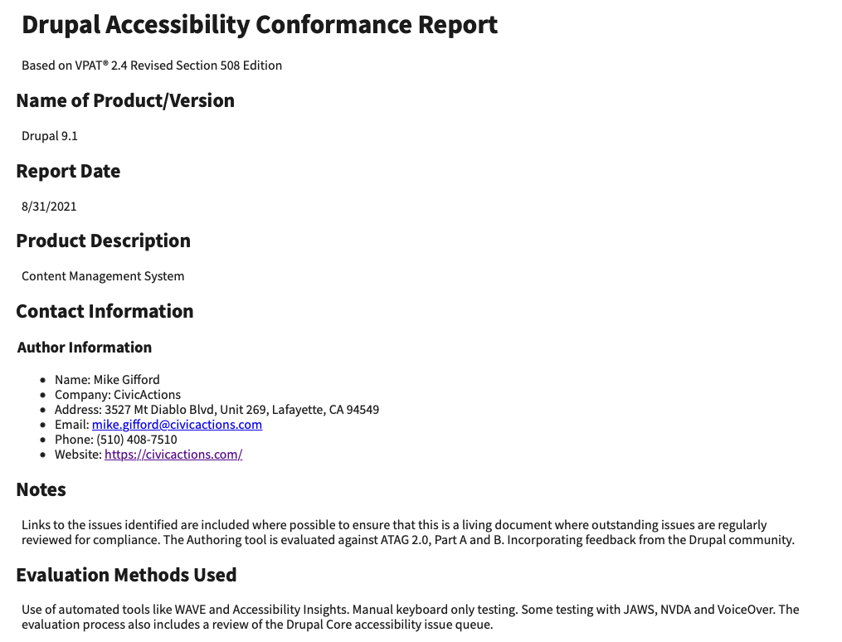
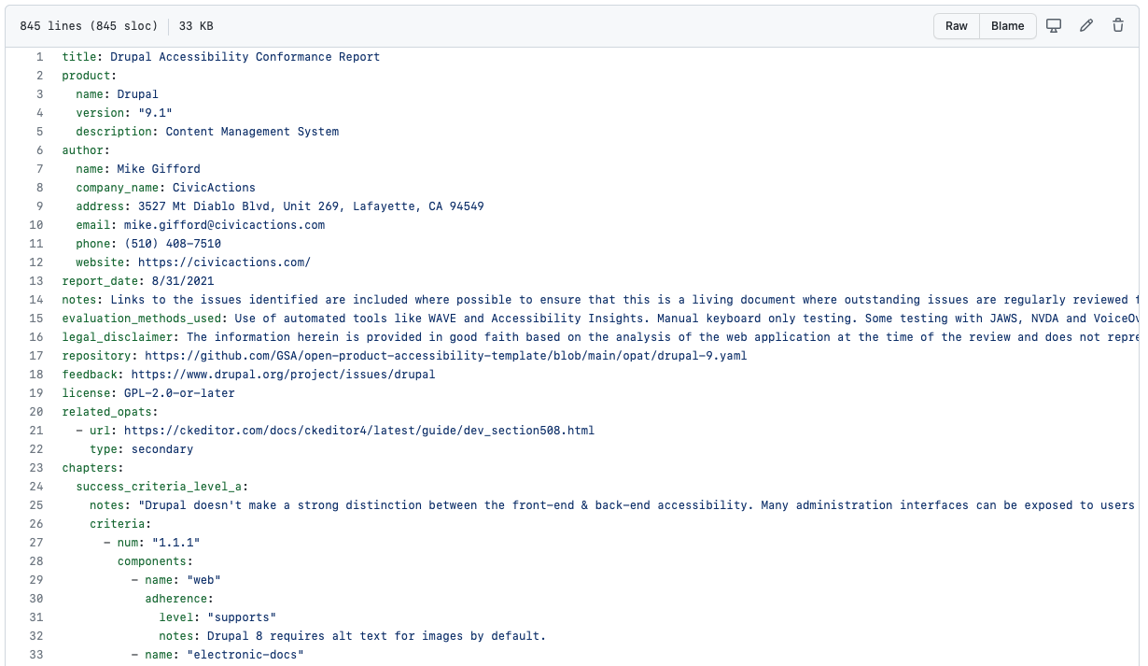
Working Prototype
YAML
HTML
Notes:
Examples of output
https://github.com/GSA/open-product-accessibility-template/tree/main/opat

Slide 8
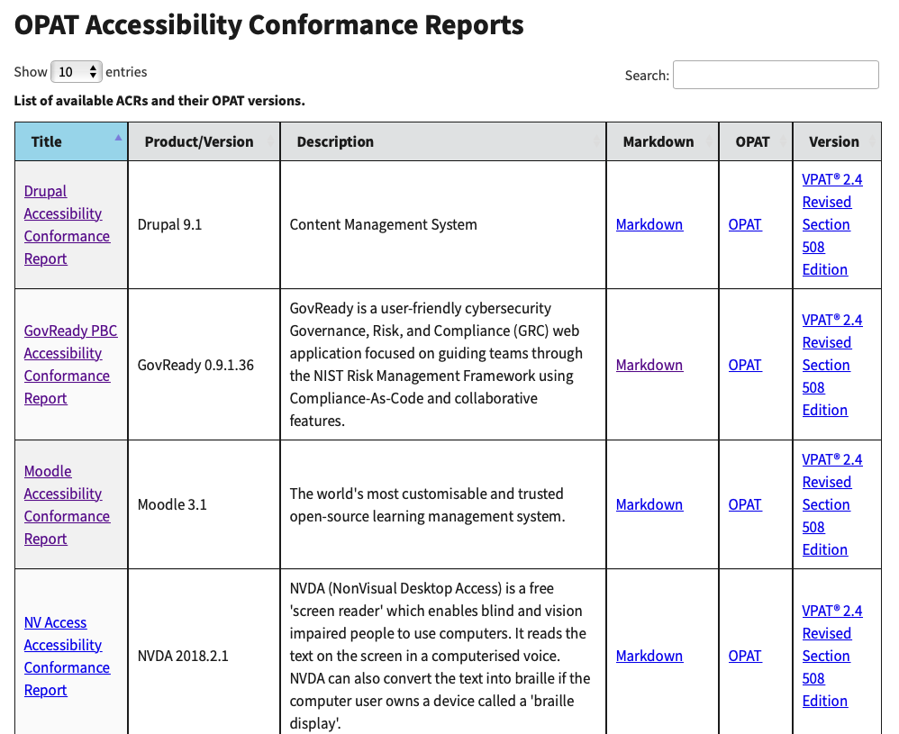
Working directory view
Directory View
Notes:
https://federalist-02947dd8-86df-467a-b2af-4c5b94c5b1f0.app.cloud.gov/site/gsa/opat-website/opat/

Slide 9
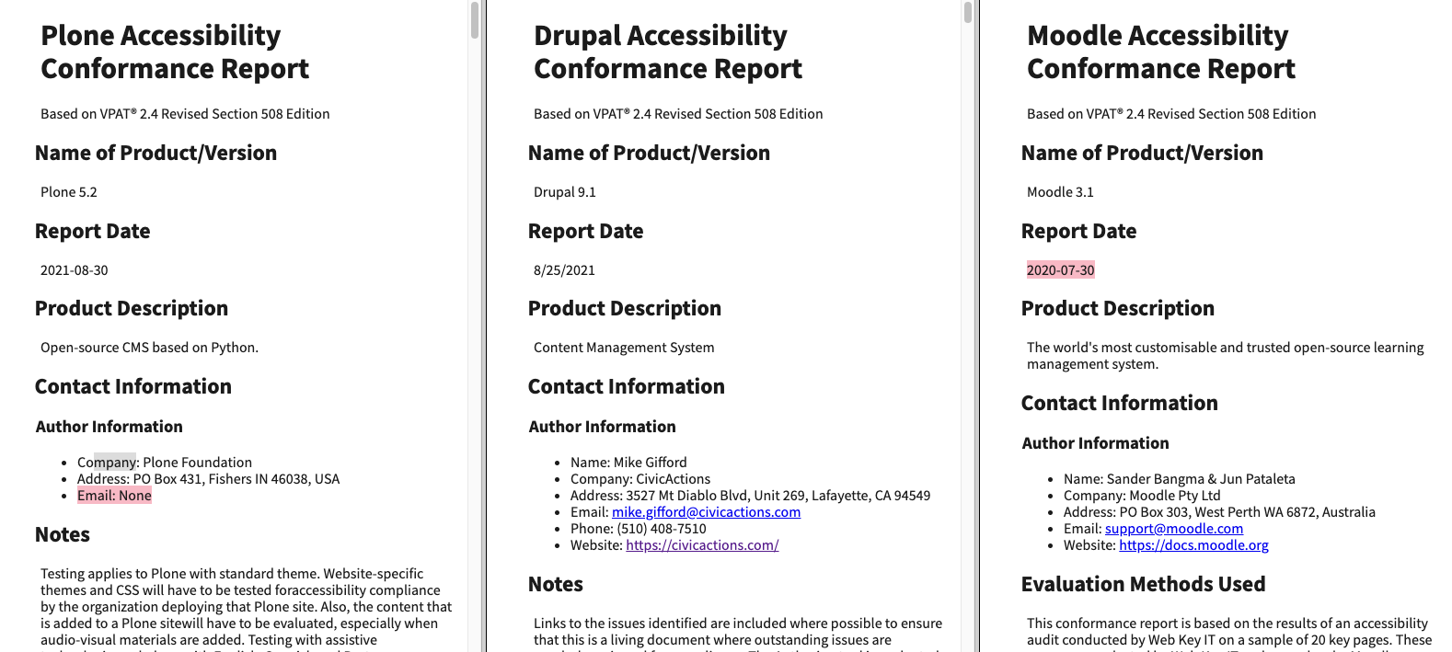
Mockup for comparison tool - 3 column view
3 different OPAT Documents in HTML frames.
Issue with context
Notes:
https://github.com/GSA/open-product-accessibility-template/issues/168#issuecomment-910536334

Slide 10
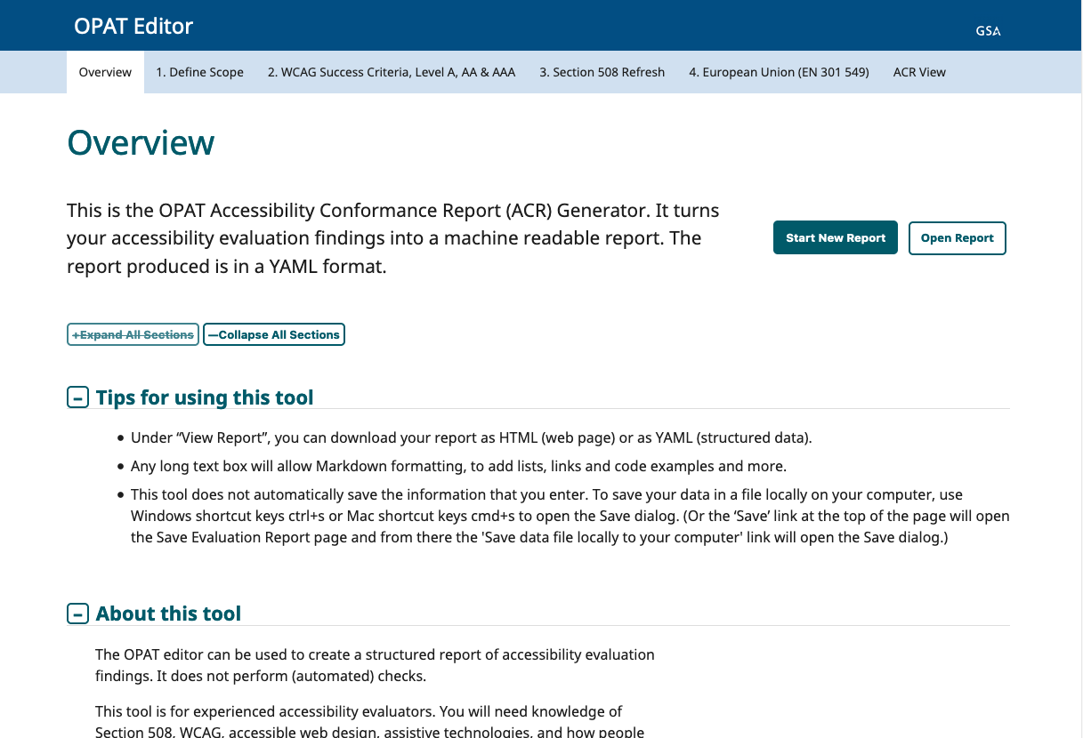
Mockup for editor tool 1/2
Description of editor
Notes:
https://github.com/GSA/open-product-accessibility-template/wiki/Possible-Walk-through-for-the-editor-interface:-Proposed-2021-Interface

Slide 11
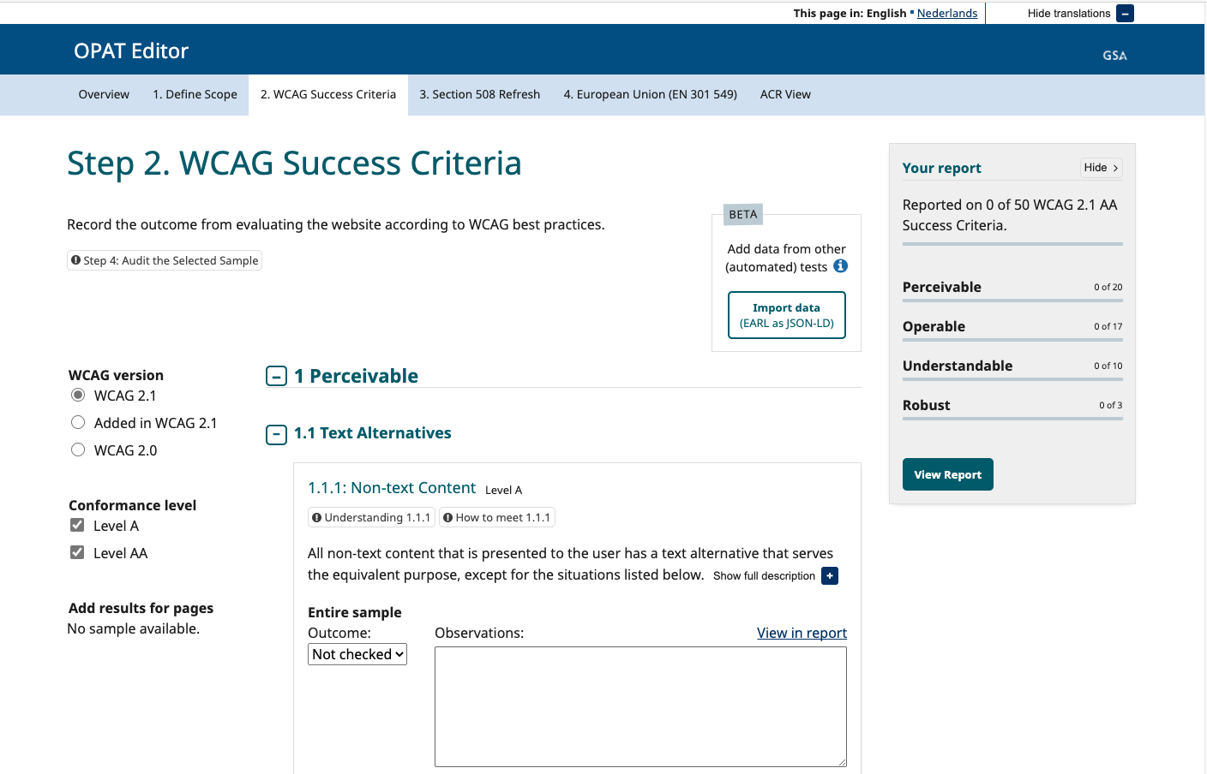
Mockup for editor tool 2/2
Working example from WCAG-EM which will be the base for the OPAT Editor
Notes:
https://www.w3.org/WAI/eval/report-tool/#!/

Slide 12
Next steps
We need people to look at the direction that we have outlined and provide feedback.
We will be building out a website, but would also like to know what would make this information easier to access.
What barriers do you see to adoption?

Slide 13

Get Involved
opat@gsa.gov
https://github.com/GSA/open-product-accessibility-template

